Slide 1
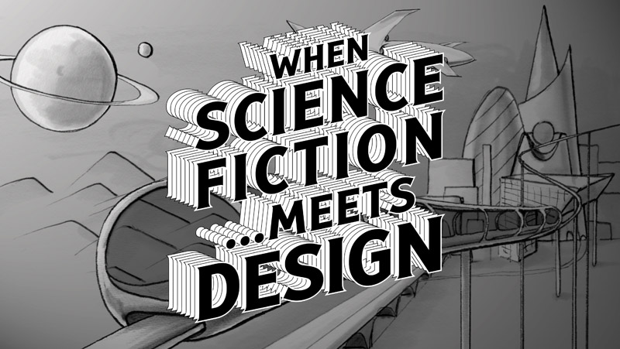
Research Design

Slide 2

Research Design
Design Science Research Designs

Slide 3
Research Design
Design Science
A definition as “an activity that contributes to the understanding of a phenomenon.” Vaishnavi, V. & Kuechler Jr, W. 2015.

Slide 4

Research Design
Design Science
The phenomenon’s typically a set of behaviours of some entity. Valid knowledge may allow prediction of some behaviour of some aspect of the phenomenon which leads to the formation of a theory.

Slide 5
Research Design
Design science also is an outcome based information technology research methodology, which offers specific guidelines for evaluation and iteration with research projects.

Slide 6
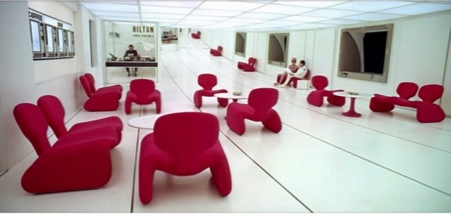
Research Design
Design science research is a set of analytical techniques and perspectives for performing research in information systems(IS).

Slide 7
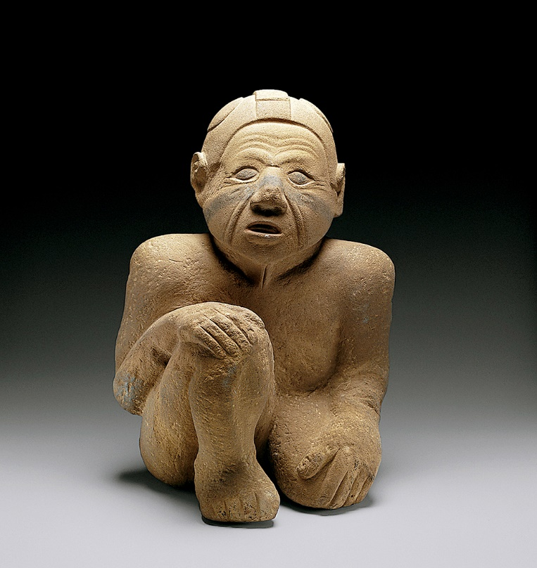
Research Design
Design Science Research (DSR) focuses on the development and performance of (designed) artifact with the explicit intention of improving the functional performance of the artifact.

Slide 8
Research Design
Design Science
Design science research involves the design of novel or innovative artifacts and the analysis of the use and/or performance of such artifacts to improve and understand the behaviour of aspects of Information Systems.

Slide 9
Research Design
Design Science
In design science research, as opposed to explanatory science research, academic research objectives are of a more pragmatic nature. Research in these disciplines can be seen as a quest for understanding and improving human performance.

Slide 10

Research Design
Design Science
The main goal of design science research is to develop knowledge that the professionals of the discipline in question can use to design solutions for their field problems.

Slide 11

Research Design
1. Design as an artifact
Design-science research must produce a viable artifact in the form of a construct, a model, a method, or an instantiation.

Slide 12
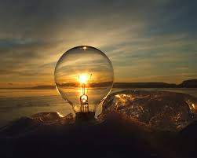
Research Design
2. Problem relevance
The objective of design-science
research is to develop
technology-based solutions to important and relevant business problems.

Slide 13
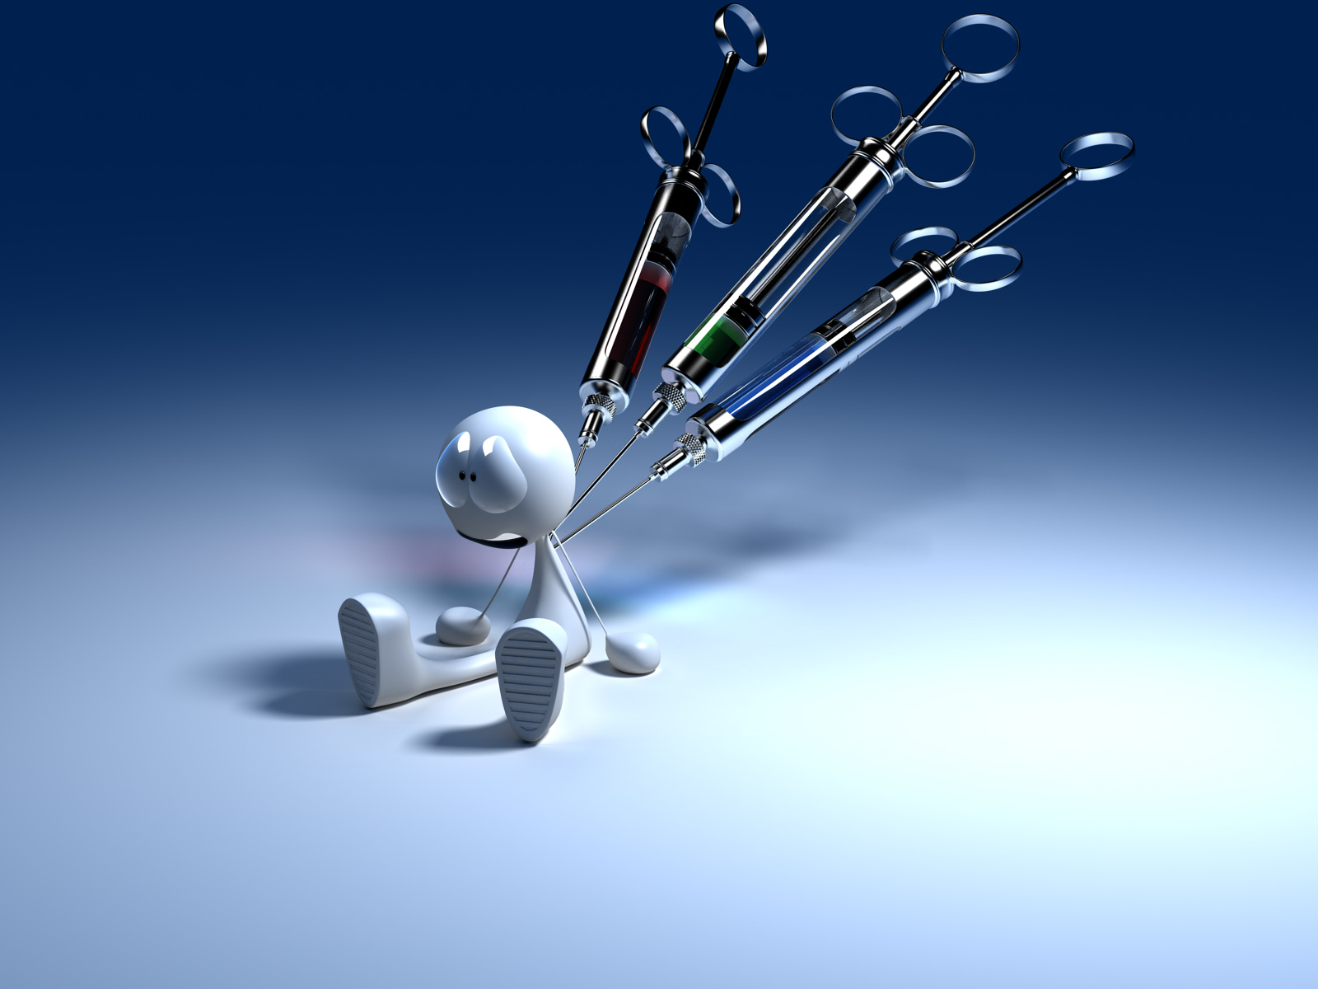
Research Design
3. Design evaluation
The utility, quality, and efficacy of a design artifact must be rigorously demonstrated via well-executed evaluation methods.

Slide 14
Research Design
To this end:
Research Contributions
Effective design-science research must provide clear and verifiable contributions in the areas of the design artifact, design foundations, and/or design methodologies.

Slide 15
Research Design
To this end:
Research Rigor
Design-science research relies upon the application of rigorous methods in both the construction and evaluation of the design artifact.

Slide 16
Research Design
To this end:
Design as a Search Process
The search for an effective artifact requires utilizing available means to reach desired ends while satisfying laws in the problem environment.

Slide 17
Research Design
To this end:
Communication of Research
Design-science research must be presented effectively both to technology-oriented as well as management-oriented audiences.

Slide 18
Research Design
Simon 1996 – the distinction between natural science and the science of the artificial.
Natural science - body of knowledge about the same class of things – object or phenomenon, explain how they behave.
Science of the artificial is the body of knowledge about the design of(man-made)objects and phenomenon. Artifacts designed to meet certain goals.

Slide 19
Research Design
Simon further frames the design of such artifacts in terms of -
Inner environment
Outer environment

Slide 20
Research Design
Inner Environment
set of components that make up the artifact and their relationship with the organization on the artifact.

Slide 21
Research Design
Outer Environment
Is the total set of external forces and effects that make up the artifact and their relationship to the organization of the artifact.

Slide 22

Research Design
So therefore Design Science is knowledge in the form of constructs, techniques and models – the knowledge for creating artifacts that satisfy a given set of functional requirements.

Slide 23
Research Design
Diagram p 15Fig 2.3

Slide 24
Research Design
The road to design, development and testing.
Awareness may come from multiple sources – proposal.
Suggestion Phase – towards tentative design is essentially a creative step. Wherein new functionality is envisioned based on a novel concept. Creative step analogous to research methods.

Slide 25
Research Design
The road to design, development and testing.
Development Phase – Tentative design is further developed and implemented. The implementation will vary depending on the artifact to be created.
Evaluation Phase – Artifact is evaluated according to the criteria. These are always implicit and frequently made explicit

Slide 26
Research Design

Slide 27
Research Design

Slide 28
Research Design

Slide 29
Research Design

